Slide 1
What is the OA?
Scouting's Honor Society

Slide 2
Ku-Ni-Eh Lodge
Service to Dan Beard since 1922
Our Origin Story
Primary Purpose
Notes:
Our origin story: we are founded for our primary purpose leadership and purpose

Slide 3
How does Ku-Ni-Eh benefit the unit?
Ku-Ni-Eh Provides numerous benefits to Scouts, Scouters, and units in Dan Beard Council.

Slide 4
Fellowship
We keep scouts, especially older scouts, involved in scouting by holding fun, engaging fellowship events. At these events, scouts get to form friendships with other arrowmen their age who are enthusiastic about scouting, and this keeps them coming back to both the OA and their home units. I know many of my friends in the OA who would have left their troop to pursue all the other activities open to teenagers had they not attended fellowship events and been encouraged to be a mentor to the less experienced scouts in their troop.

Slide 5
Fellowship
2. As for the time spent at OA events, your unit probably won’t even notice
the few days a year your scouts are gone, since they almost always attend many more troop events than they did before. For some older scouts, the choice is between coming to a fun Lodge event or not participating in anything scouting related. And once they meet everyone in the OA who is engaged with their troops and crews, scouts usually find their scout spirit again.

Slide 6
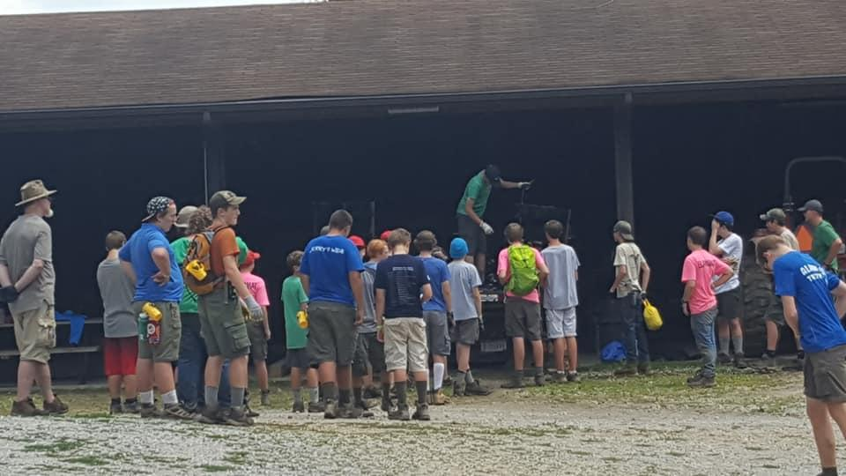
Service
Service to Camp
  Friedlander
    Tents Up/Down
    Summer Camp OA Program
    Conservation
      Trees/Honeysuckle
    Construction/Repair
      Tent Cots

Slide 7
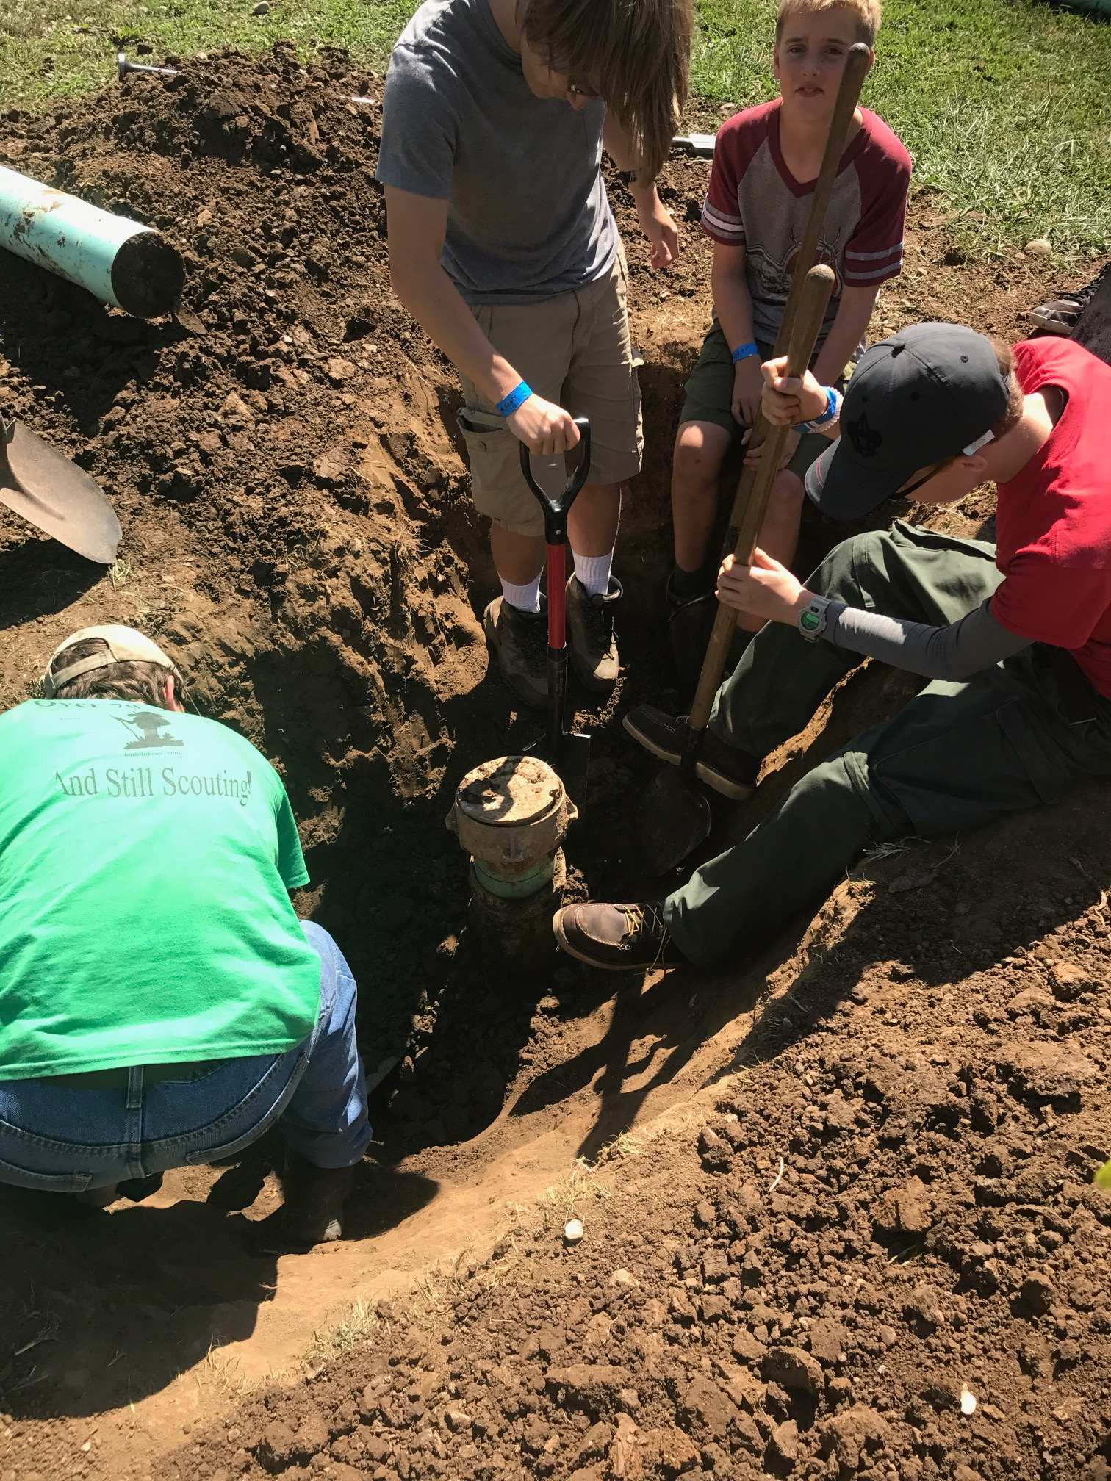
Service
Service To Camp
  Cubworld
    Tents Up/Down
    Spook-O-Ree
    Maintenance

Slide 8
Forging Leaders
Leadership Training
  Lodge Leadership Development (LLD)
    General Instruction
    Individually Tailored Courses
  National Leadership Seminar (NLS)
    Regional Training
    Most experienced Youth Trainers in the Nation
    Lodge Funded

Slide 9
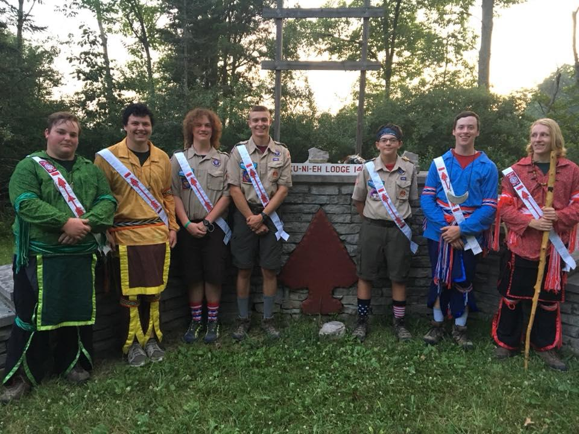
Forging Leaders
Leadership Opportunities
  Something for Everyone in Committies
    Ceremonies
    Technology
    Event Planning
    Craftsmanship
    Finances

Slide 10
Forging Leaders
Leadership Opportunities
  Project Management
    Inductions Team
      Elangomats, ordeal master, runners, etc..
      100+ scout service projects
    Event Planning
      Fellowships
      Winter Banquet

Slide 11
Forging Leaders
Leadership Opportunities
  Leadership Positions
    Chapter Chiefs
    Chairpersons
    Lodge Officers

Slide 12
Eagle Scout Support
Ku-Ni-Eh Lodge provides support to those earning Eagle
  Friends from around the council
  Making Connections
  Support from other arrowmen
  Special Recognition
    OA Eagle Ceremonies/Awards

Slide 13
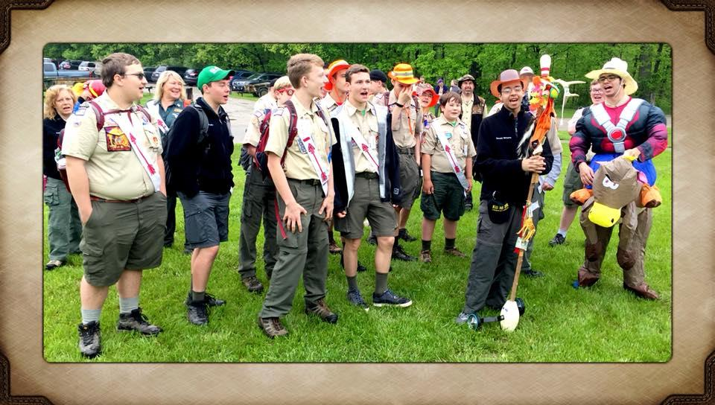
Keeping Scouts Involved
Exciting Opportunities
  Lodge Events
  Conclave
  NOAC
  High Adventure

Slide 14
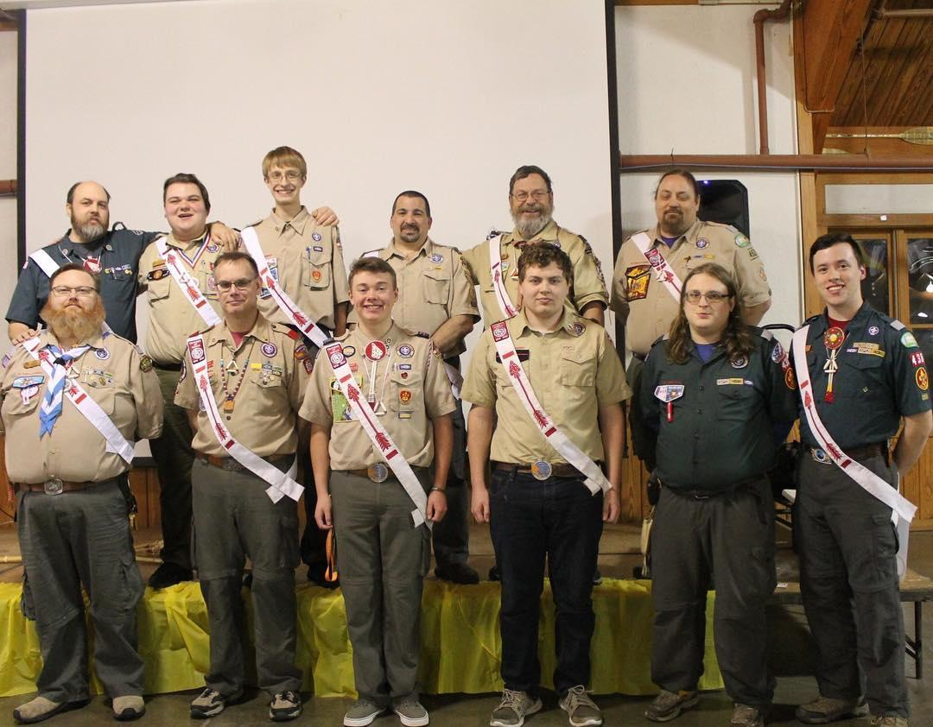
Keeping Scouts Involved
Another Chapter in the Scouting Journey
  Leadership Positions
  Awards and Honors
  Friendships

Slide 15
Any Questions?
Q&A

